Slide 1
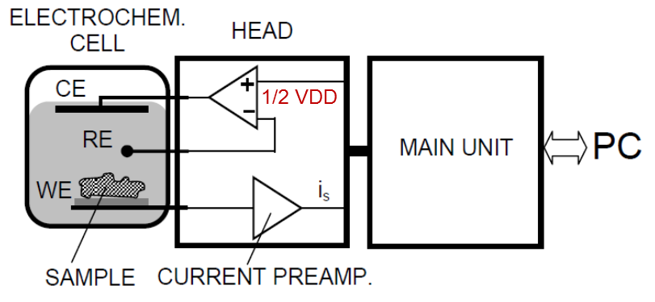
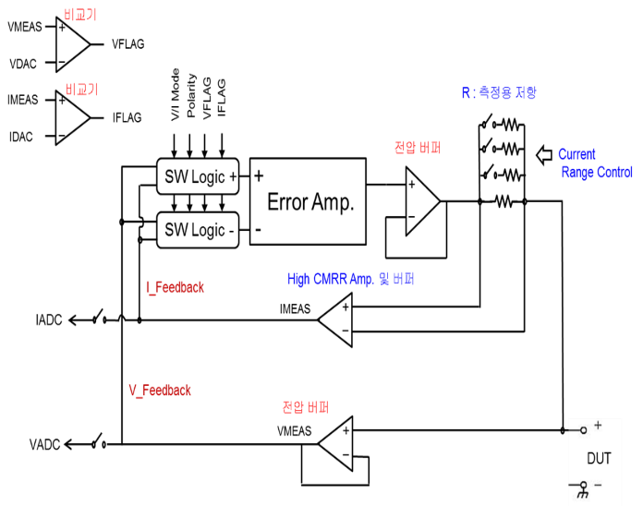
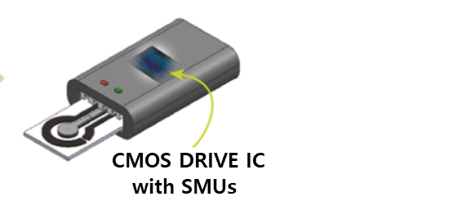
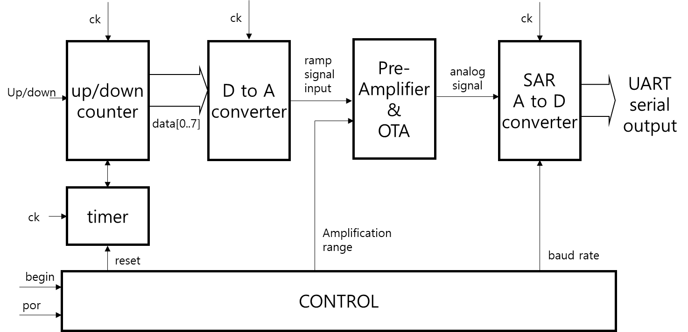
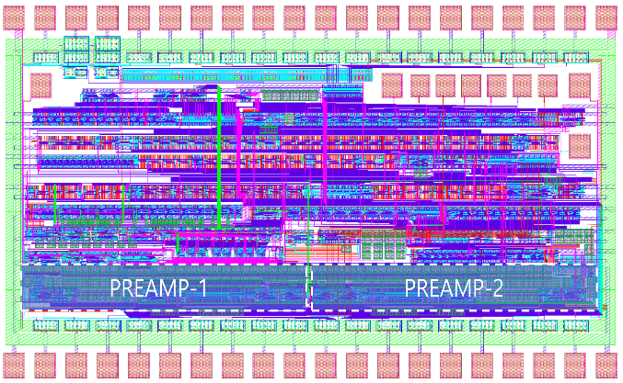
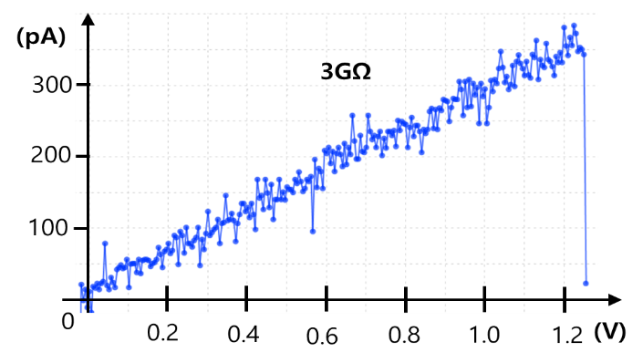
A Micro-Sensor and Controller Chip with 4 Programmable Source and Measurement Units and a 10b Serial Output ADC for Wearable Health Monitoring Applications
Seongwook Choi, Jinhong Ahn and Young June Park
Department of Electrical and Computer Engineering, Seoul National University,
Seoul 151-744, Republic of Korea
With the development of small electronics technology using semiconductors, methods for wearable health monitoring are also diversifying. We presented a electrochemical blood glucose monitoring using a CMOS sensor chip. This can reduce the sensor size and weight needed for various wearable applications.
<Source and Measurement Unit Circuit>
<Concept of Wearable Electro-
chemical sensor by 3-electrodes>
<2-stage current pre-amp. and V converter>
<Overall Block Diagram of CMOS Chip>
< Chip Layout and Measurement Result >
We developed a micro-sensor/controller chip with 4 programmable SMUs for wearable health monitoring applications. By shifting the GND level to ½ VDD, and with analog switch(SW) control, SMUs, used for 3-electrode electrochemical application can apply voltage or current in both (+) and (-) directions. To reduce the feedback resistor size of pre-amplifier, we used long channel MOS’s biased at subthreshold region. The SMUs and preamplifiers can be programmed using UART interface, and the measured result can be output serially by using 10b SAR A to D converter. We showed pA level current can be measured by using 2-stage pre-amplifier for 3GΩ WE resistance test.
The chip fabrication and EDA tool were supported by the IC Design Education Center(IDEC), Korea.

